Slide 1
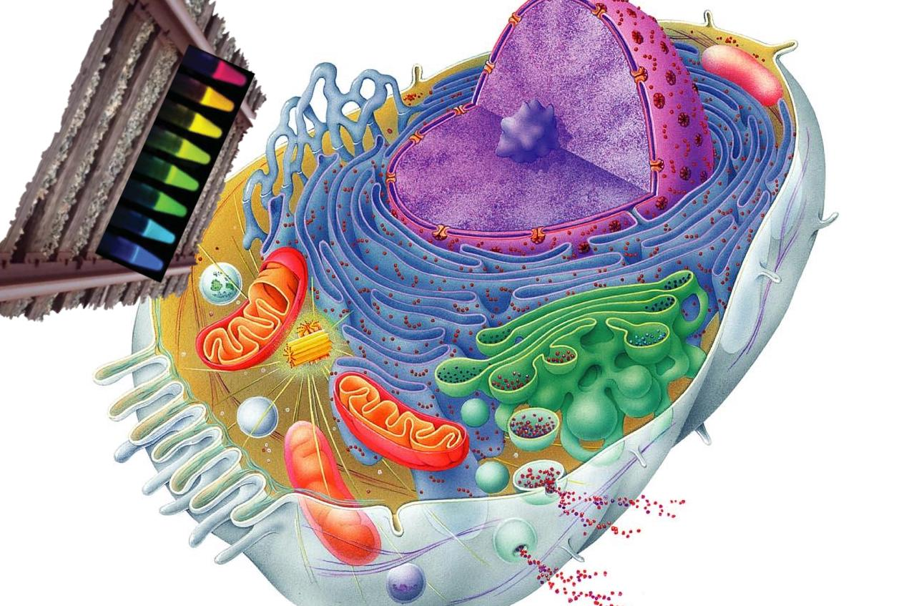
Cell Organelle Classifier
Iftekher Mamun

Slide 2
Purpose and Why
Identify cellular organelles based on their structure
Specific proteins interact with specific sequences of other proteins in organelles causing them to light up
Can help identify protein-protein interaction based on organelle selection
Can help visualize mutated cells, based on structures of organelles

Slide 3
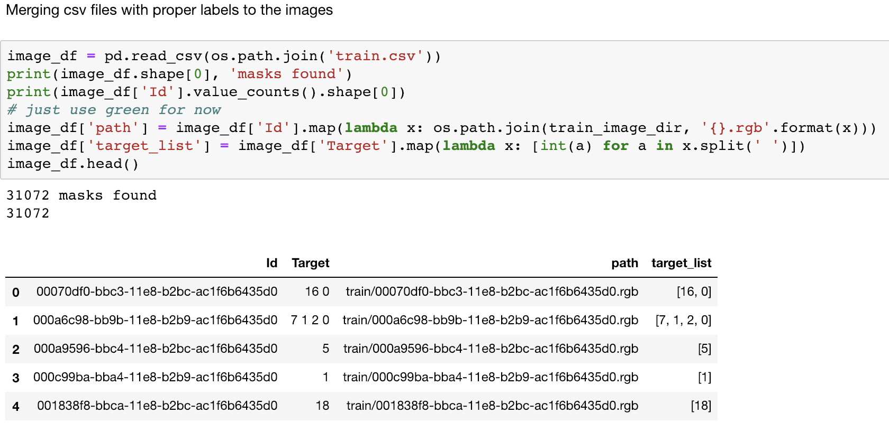
The Data
Data from :
Kaggle and the Human Protein Atlas
Data labels in csv, images unlabeled
Link images using OS.path.join

Slide 4
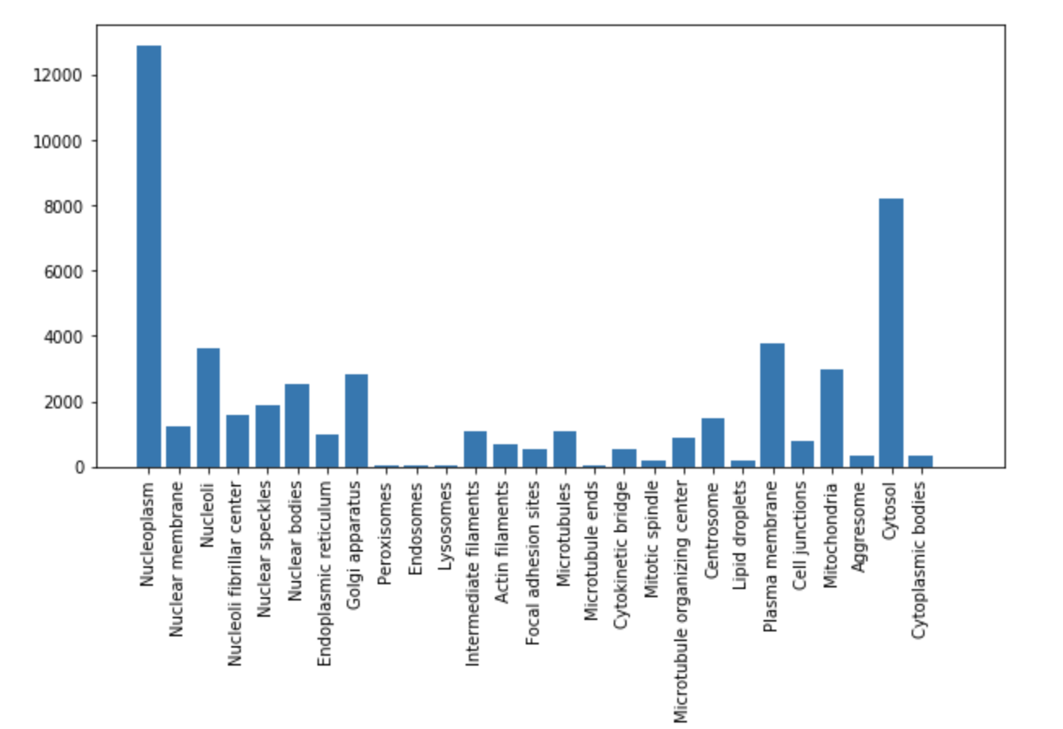
The Data

Slide 5
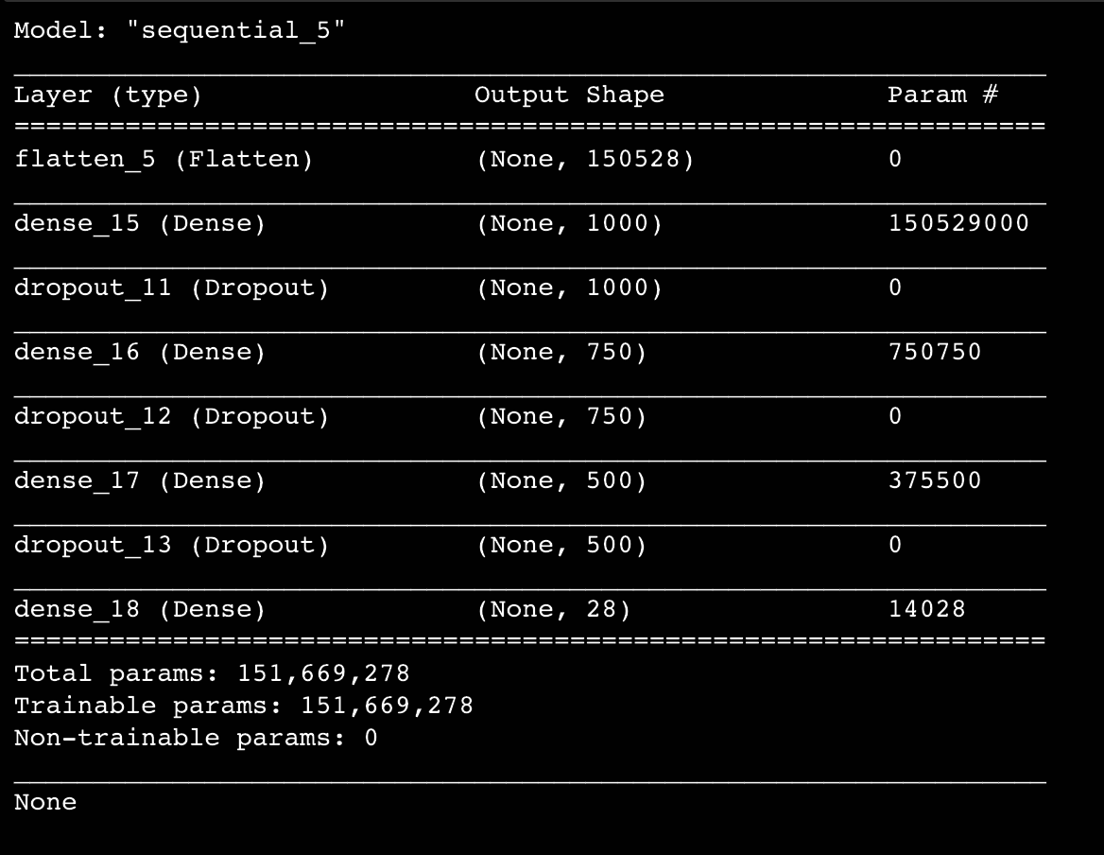

Convolutional Neural Network: Transfer Learning on VGG16
Hidden Layer Activation= 3 LeakyReLu with alpha 0.3
Dropout= 3
Activation Function= sigmoid
Optimizer= adam
metric= binary

Slide 6
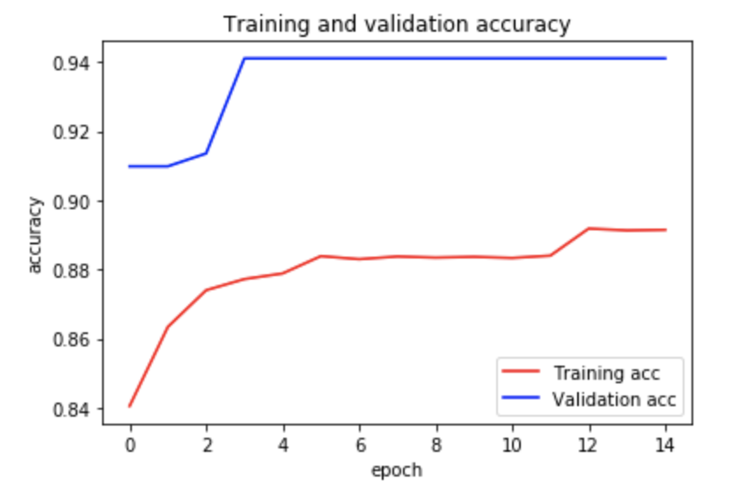
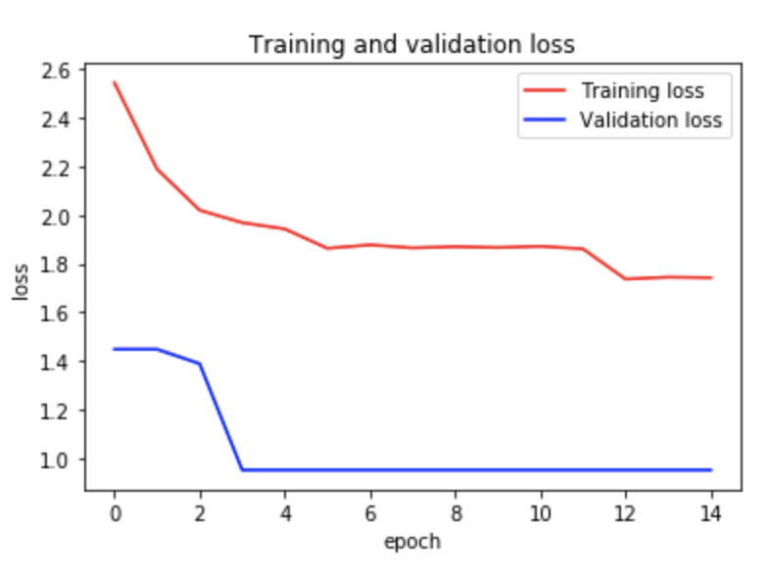
Accuracy and Loss of Training and Validation

Slide 7
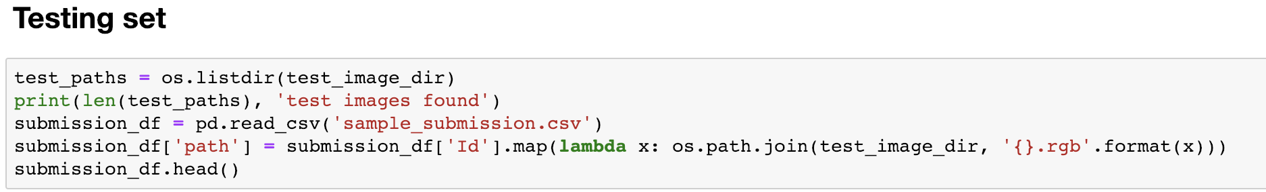
Creating the test set labels and path in the same manner as training set samples

Slide 8
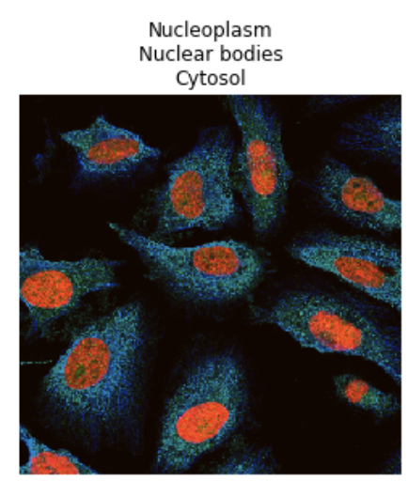
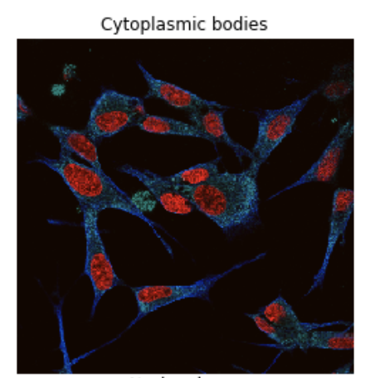
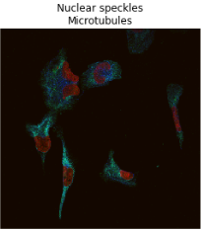
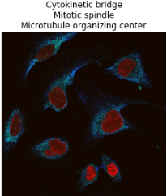
Correct Predictions

Slide 9
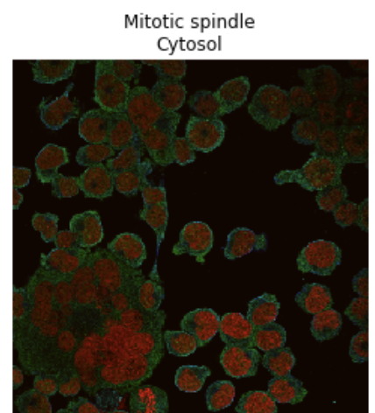
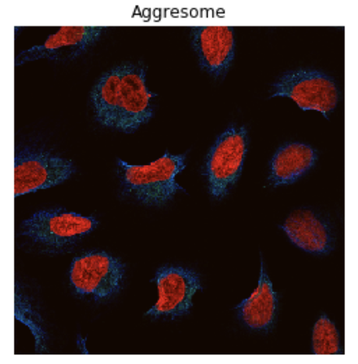
Partially Correct Predictions

Slide 10
Next Steps
Make a classification metric and confusion matrix
For better accurate result representation
Link specific protein sequences to each organelles
Identify and mark organelles in between cellular reproduction
Identify mutation changes within each cell
Identify chemical signalling pathways using proteins
Cell organelle communications
Cell to cell communications

